Slide 1
Max Flow Networks
Push Re Label Algorithm

Slide 2
Push-relabel algorithm is described by Dr.Andrew Goldberg and Rober E Tarjan
Leads to better running time
All previous Network Flow related algorithms are related to augmentation
A draw back of aug-based schemes :
Each augmentation takes O(n) time
Multiple augmentation may partially share paths, but it’s not exploited by algorithms
Not very hard to code
Considered as Fastest Maximum-flow algorithm

Slide 3
Push Relabel Maximum Flow Algorithm is an algorithm used for finding the maximum flows in a flow network.
Push Relabel Maximum Flow Algorithm is more efficient in comparison to the Ford-Fulkerson algorithm.
Push Relabel Maximum Flow Algorithm and Ford-Fulkerson both use residual graphs of flow networks.

Slide 4
Push Relabel Maximum Flow Algorithm is an algorithm used for calculating the flow network maximum flows.
It uses a residual graph of the flow network.
There is a flow network shown in the below-given graph in which all edges have a capacity.
In this graph, there are two vertices source 's' and 't' as a sink. Using the below-defined constraints, determine the maximum possible flow from s to t:
The capacity of the given edge must be greater than the flow of the edge.
Except for s and t, the incoming and outgoing flow of every edge in the graph should be equal. Below is an example of a graph (taken from the CLRS book)

Slide 5
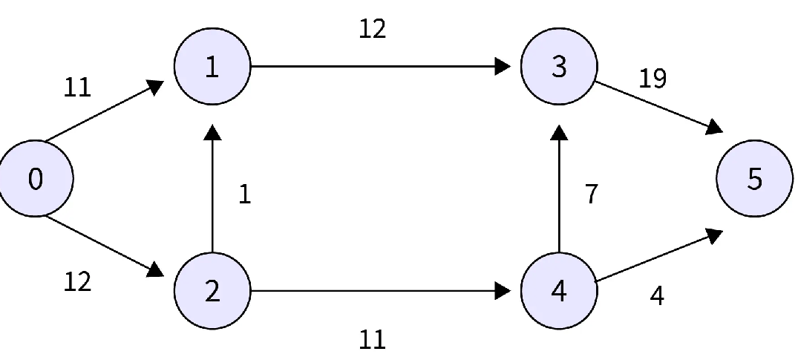
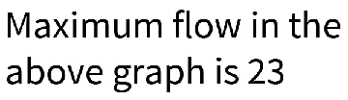

Slide 6
Push-Relabel Algorithm:
1. PreFlow Initialization: Initialization of heights and Flows.
2. While performing relabel() and push() on the vertex is possible.
//Or while there exists a vertex with the excess flow.
Do Relabel() or Push()
//Now all vertices except the source and sink vertex have the value of Excess Flow as 0.
3. Return the flow.

Slide 7
Mainly there are 3 operations in the Push Relabel Maximum Flow Algorithm:
PreFlow() Initialization Flows and heights of all the vertices are initialized by it.
Pre flow()
1) Initialization of every vertices flow and height with 0.
2) Height of the source vertex is initialized with the total vertices in the graph.
3) Every edge flow is initialized with the value 0.
4) Initially the value of flow and excess flow of all the vertices that are adjacent to the source s is equivalent to the capacity.

Slide 8
Push()
For creating the flow from the node having excess flow, the push() operation is used.
Suppose in a residual graph, a condition occurs when there is excessive flow in a vertex and an adjacent of smaller height is there, then the push() operation is used to push the flow from the vertex to the adjacent having lower height.
And the value of the pushed flowing from the pipe (edge) is equivalent to the minimum of two values i.e. a minimum of capacity and excess flow of the edge.

Slide 9
Relabel()
When there is excess flow in the vertex and there is no adjacent at the lower height, then in this condition relabel() operation is used.
For performing push(), we generally increase the height of the vertex.
So for increasing the height of the vertex, we need to choose the adjacent in the residual graph having minimum height. And after this, we add 1 to this particular adjacent.

Slide 10
Step-wise Example
Generally, residual graphs are not similar to normal graphs, they both are different.
So first before proceeding with the example of the Push Relabel Maximum Flow Algorithm, we will learn about the residual graph.
Additional possible flow is indicated by the residual graph of the flow network.
In a residual graph adding flow is possible if there exists a path from source to sink.
In the residual graph, every edge is associated with the value called residual capacity and its value is equal to the difference between the current flow and original capacity.

Slide 11
Residual capacity is generally represented by the edge's current capacity.
We need to do the following updates if we add or push flow from vertex u to v:
We find the difference of flow and the capacity of the edge from u to v. And if the edge capacity is zero, then the particular edge is not allowed to stay in the residual graph, it will no longer exist.
Addition of flow capacity of the edge from v to u.

Slide 14
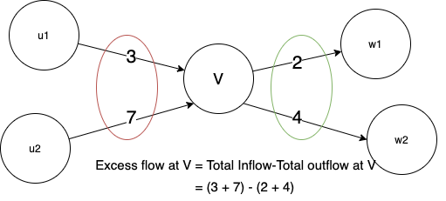
Push operation
Every vertex is also assigned another variable excess flow. When a vertex has an excess flow, it pushes it to a lower height vertex. The amount of flow pushed is equal to the minimum of excess flow of vertex and capacity of connecting edge.
Excess flow at a vertex V is defined by: Total flow received by V - Total flow going out of V.
Relabel operation
If the height of a vertex is low and the water is overflowing in that vertex, i.e the water gets locally trapped, then it's relabeled. In a relabel operation, the height of the vertex is increased.

Slide 15
Steps:
Initialize the graph with a preflow and the labelling functions with each edge outgoing from s with its maximal capacity and all other edges with zero.
Push() - We push as much excess flow from one Vertex u to a neighboring vertex v.
Relabel() - We will increase the Vertex's height when we cannot push the excess to any adjacent vertex. Also, we can expand it by as much as possible while still maintaining the validity of the labeling.
At the end all the vertices should have 0 excess flow
Return maximum flow

Slide 16
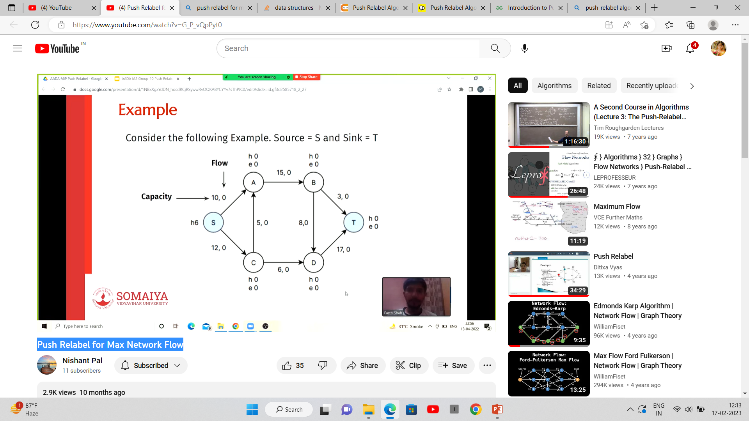

Slide 17
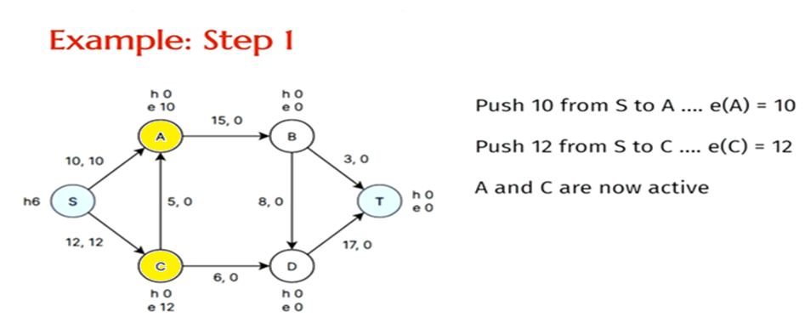
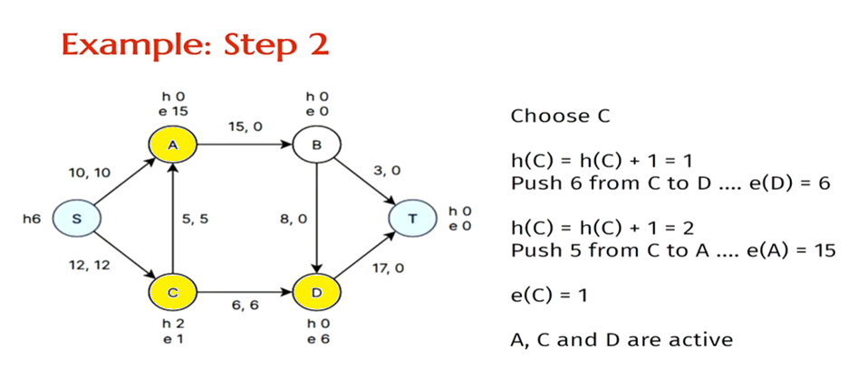

Slide 18
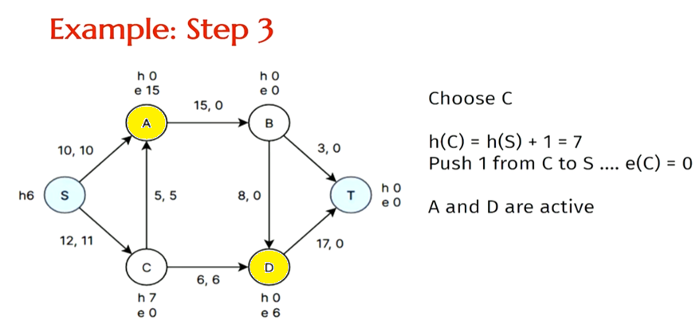

Slide 19
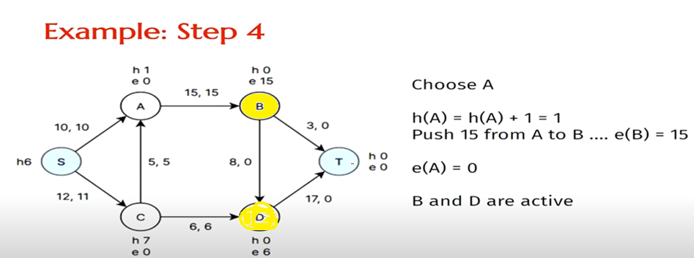
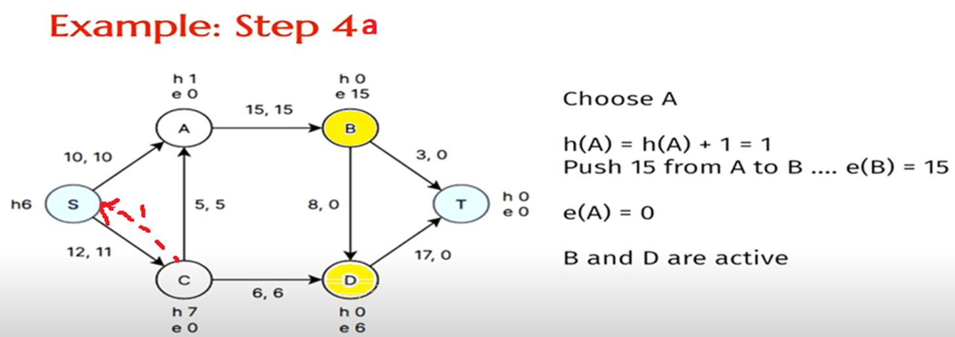

Slide 20
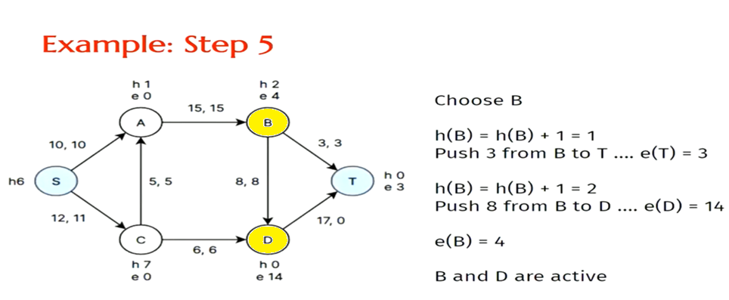
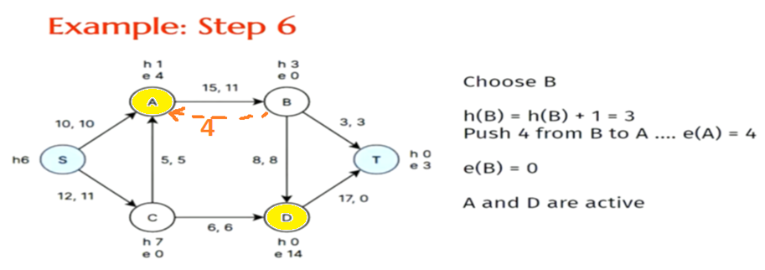

Slide 21
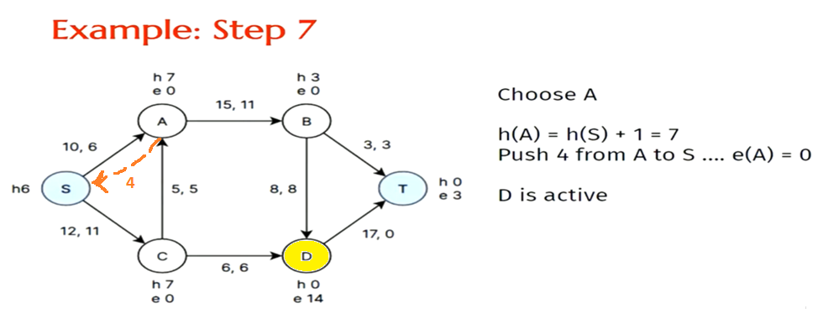
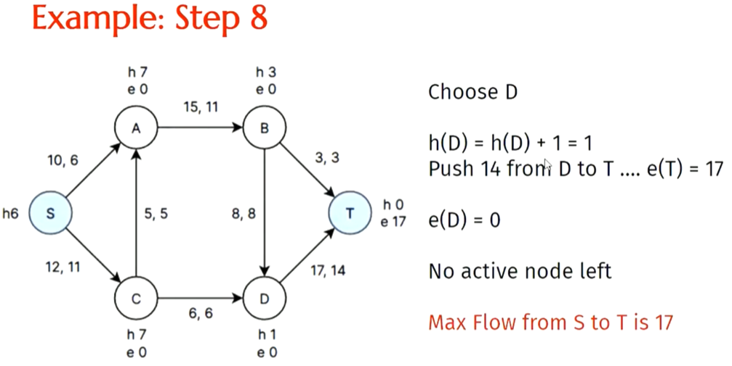

Slide 22
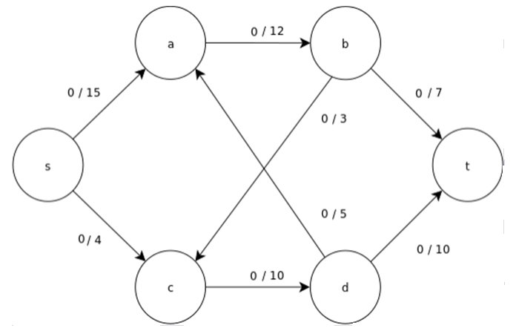
Ex : 1

Slide 23
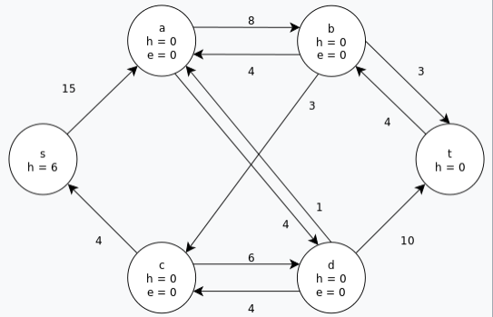
Initialize the residual graph by setting the pre flow to values 0 and initializing the labeling.

Slide 24
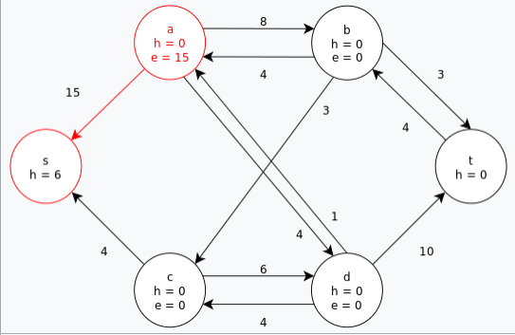
Initial saturating push is performed across all pre flow arcs out of the source, s.

Slide 25
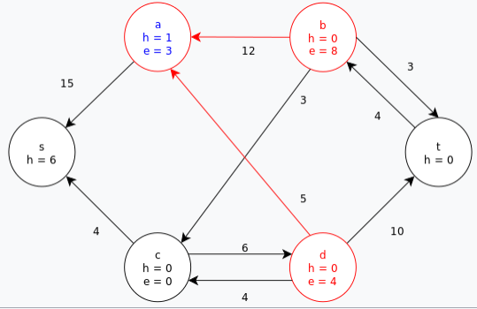
Node a is relabeled in order to push its excess flow towards the sink, t. The excess at a is then pushed to b then d in two subsequent saturating pushes; which still leaves a with some excess.

Slide 26
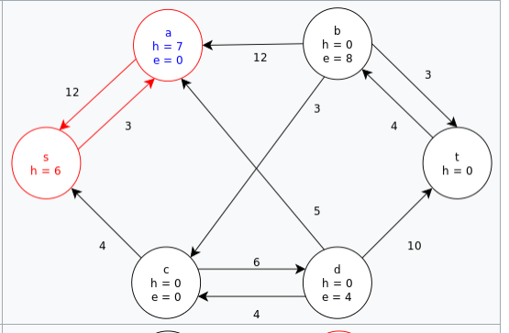
Once again, a is relabeled in order to push its excess along its last remaining positive residual (i.e. push the excess back to s).The node a is then removed from the set of active nodes.

Slide 27
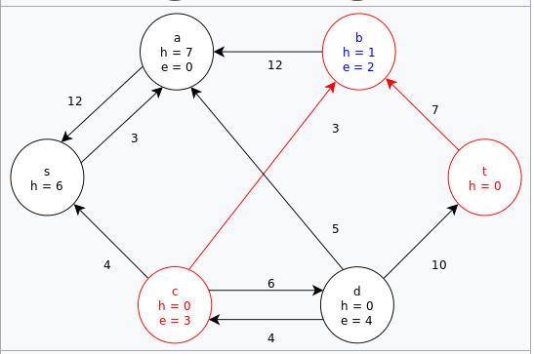
Relabel b and then push its excess to t and c.

Slide 28
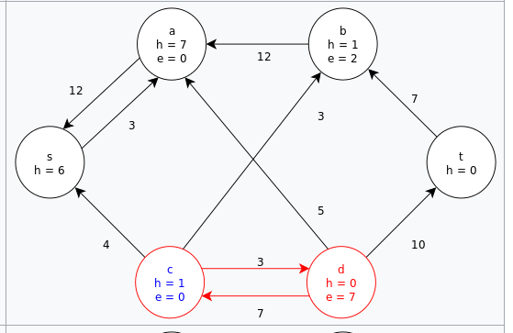
Relabel c and then push its excess to d.

Slide 29
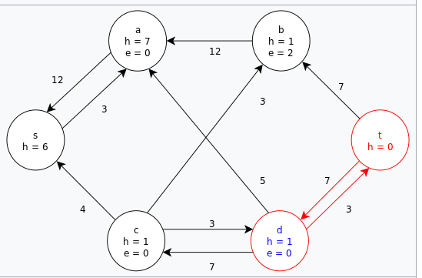
Relabel d and then push its excess to t.

Slide 30
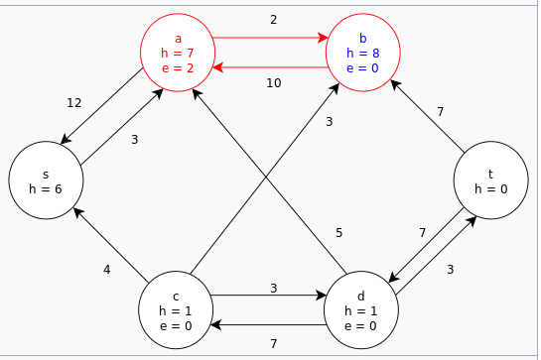
This leaves the node b as the only remaining active node, but it cannot push its excess flow towards the sink. Relabel b and then push its excess towards the source, s, via the node a.

Slide 31
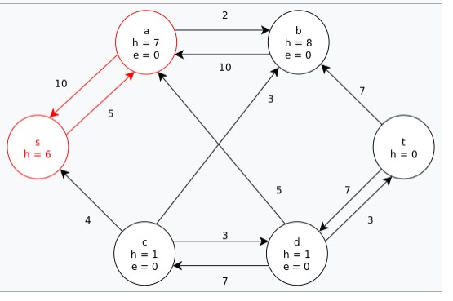
Push the last bit of excess at a back to the source, s. There are no remaining active nodes. The algorithm terminates and returns the maximum flow of the graph (as seen above).

Slide 32
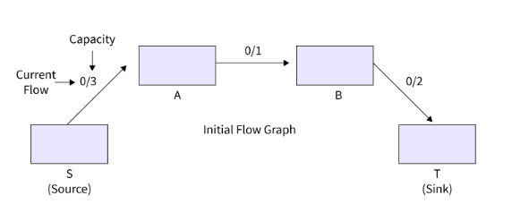
Let us take an example, suppose there are two vertices x and y. And in the original graph 3/10 x ---------> y current flow from x to y is 3 and edge capacity from x to y is 10.
And there are two edges in the residual graph for the above-shown edge. 7 x ---------> y 3 x <--------- y
The flow graph needs to be initialized.
Refer to the below for step1 of the example.

Slide 33
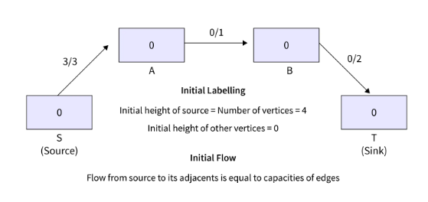
There is a formation of an edge having capacity 3 from A to S and there is no edge from S to A after performing the PreFlow operation in the given residual graph.

Slide 34
Relabel the vertex that is highlighted (now length becomes 1) as there is an excess flow and no adjacent of smaller height.
Now the new value of the height is equal to the minimum heights of residual + 1.
Vertex S and B are two adjacent vertices for A in the residual graph.
And if we compare the height of both and then we get the minimum height of B i.e. 0 as the height of S is 4 and the height of B is 0. So we take 0 and add 1 into it and it becomes 1.

Slide 35
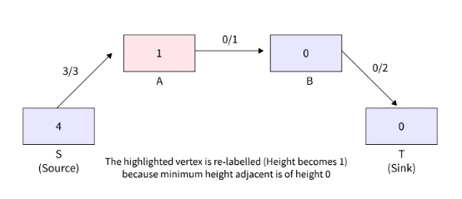

Slide 36
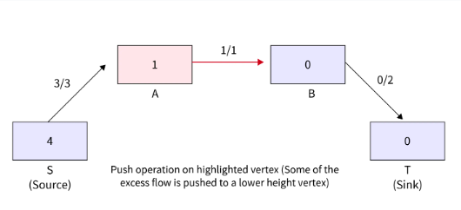
Push() operation takes place as there is an excessive flow in the highlighted vertex and there is an adjacent having a lower height.
At vertex A, the excess flow is 2 and there is an edge (A, B) with a capacity of 1.
2 is the minimum of two values and that is the amount of flow that is pushed.

Slide 37
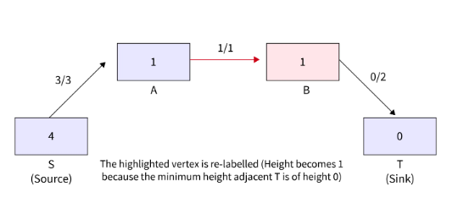
The highlighted vertex is relabeled (height becomes 1) as it has excess flow and there is no adjacent with smaller height.

Slide 38
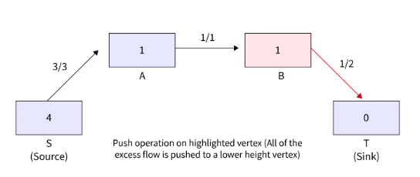
Flow () operation from B to T takes place as there is an excess flow in the highlighted vertex and an adjacent having a lower height is there.
The highlighted vertex has excess flow and there is an adjacent with lower height, so flow() is pushed from B to T.

Slide 39
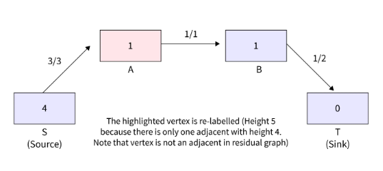
The highlighted vertex is relabeled (height becomes 5) as it has excess flow and there is no adjacent with smaller height.

Slide 40
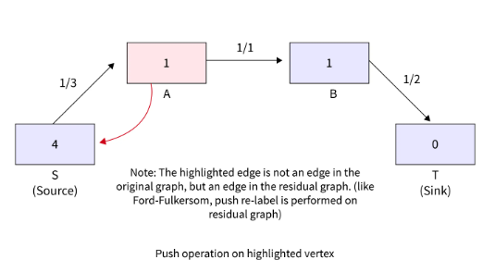
The highlighted vertex has excess flow and there is an adjacent with lower height, so push() happens.

Slide 41
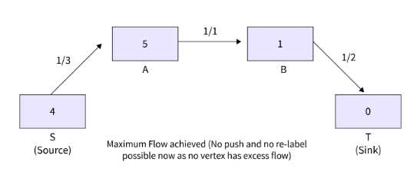
The highlighted vertex is relabeled (height is increased by 1) as it has excess flow and there is no adjacent with smaller height.

Slide 42
Conclusion
Push Relabel Maximum Flow Algorithm is an algorithm used for calculating the flow network maximum flows.
It is more efficient in comparison to the Ford-Fulkerson algorithm.
Push Relabel Maximum Flow Algorithm and Ford-Fulkerson both use residual graphs of flow networks.
For finding an augmenting path this works on one vertex at a time instead of examining the whole residual network.
Additional possible flow is indicated by the residual graph of the flow network.
preFlow(), push(), and relabel() are the three main operations of the Push Relabel Maximum Flow Algorithm.

